Slide 1

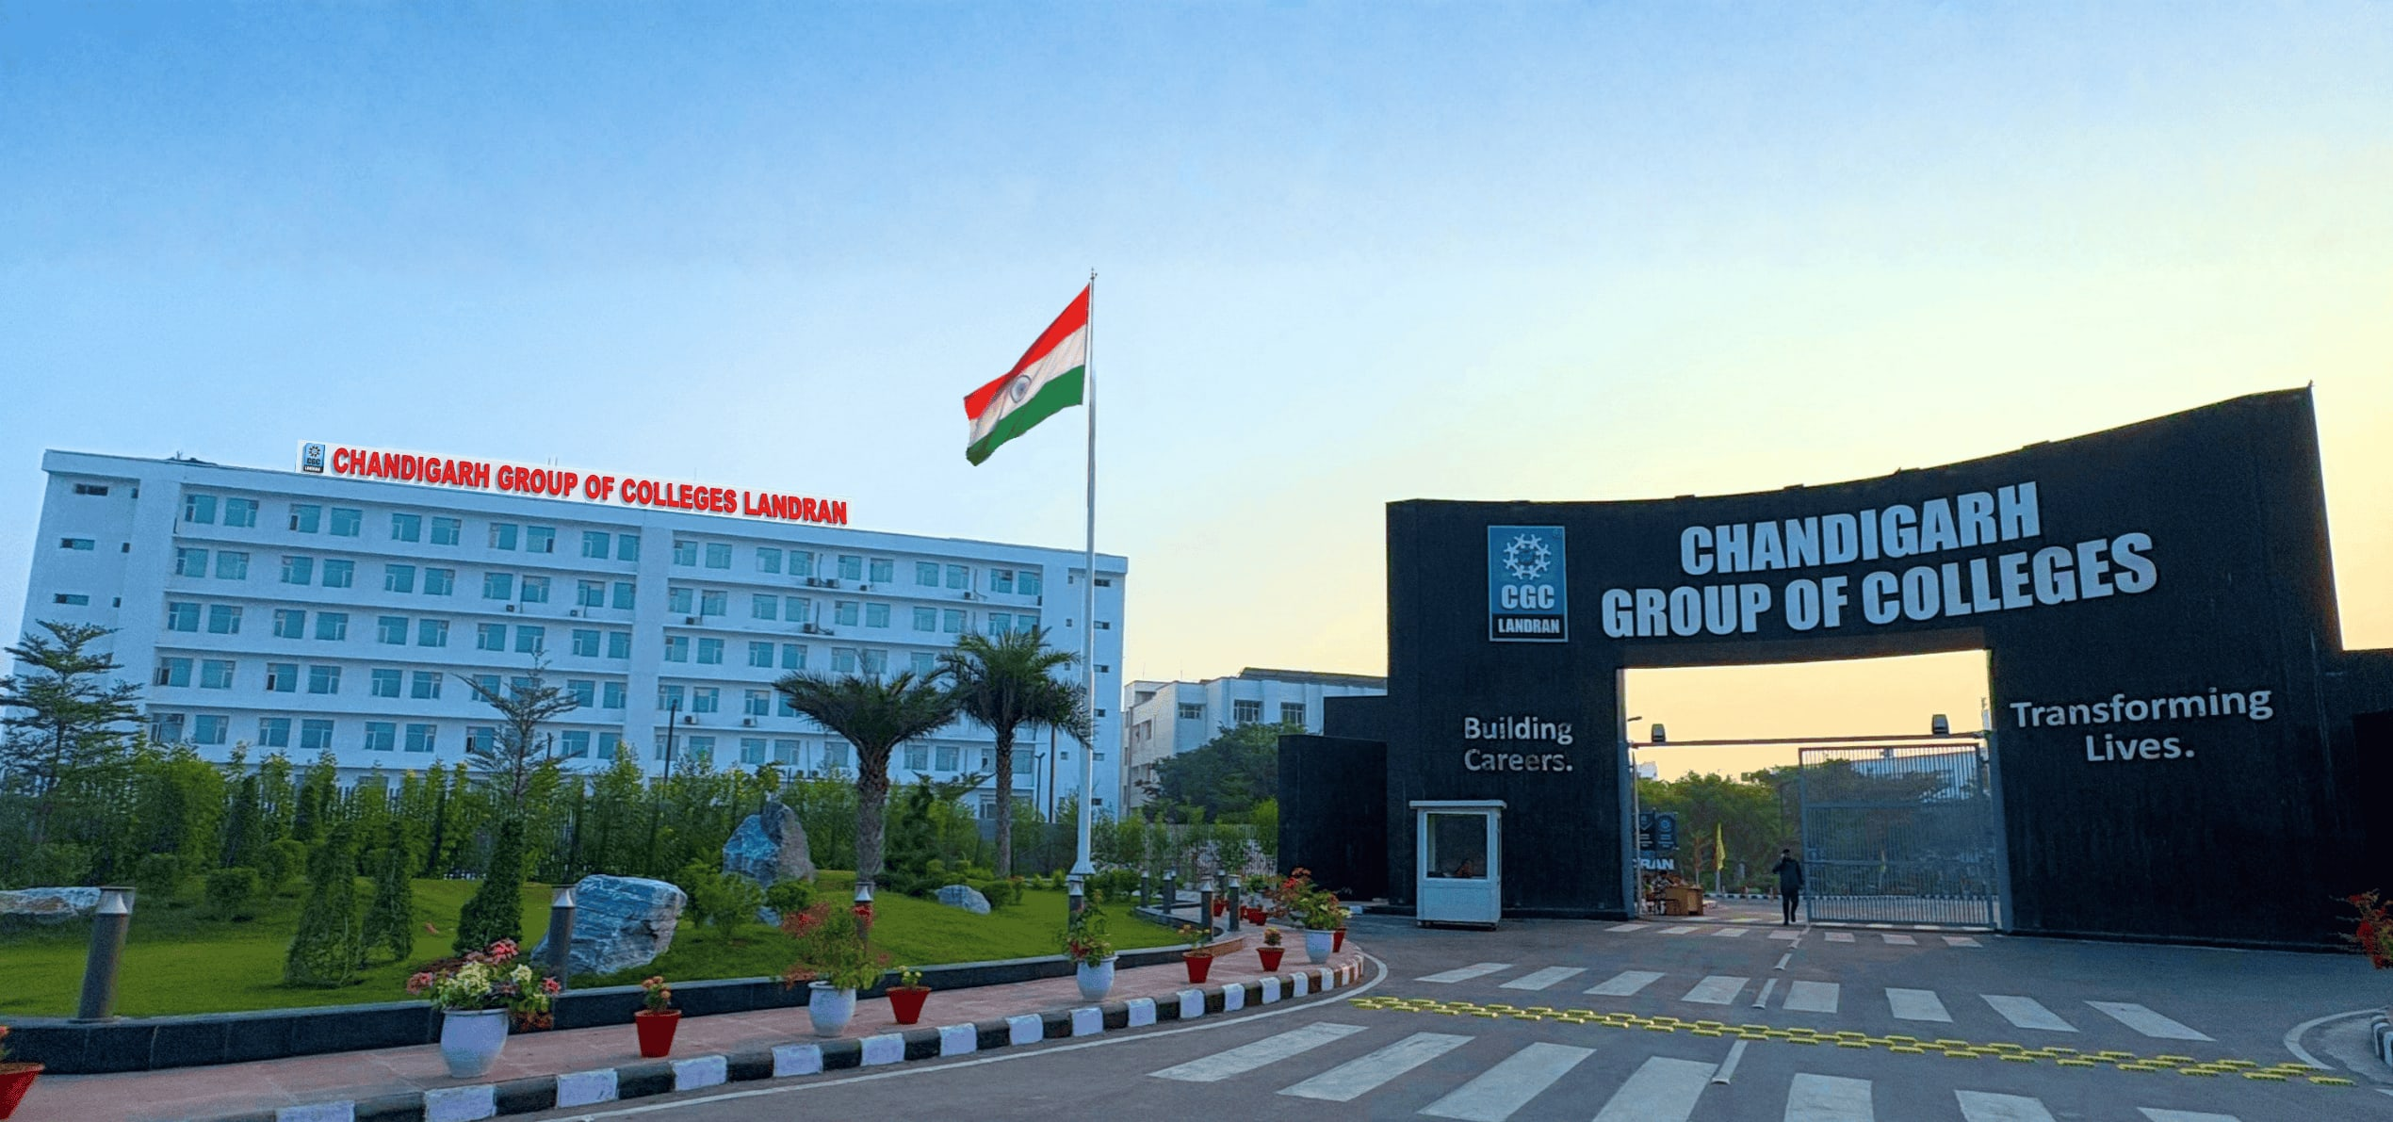
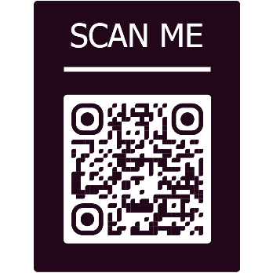
MAIN LIBRARY

Slide 2
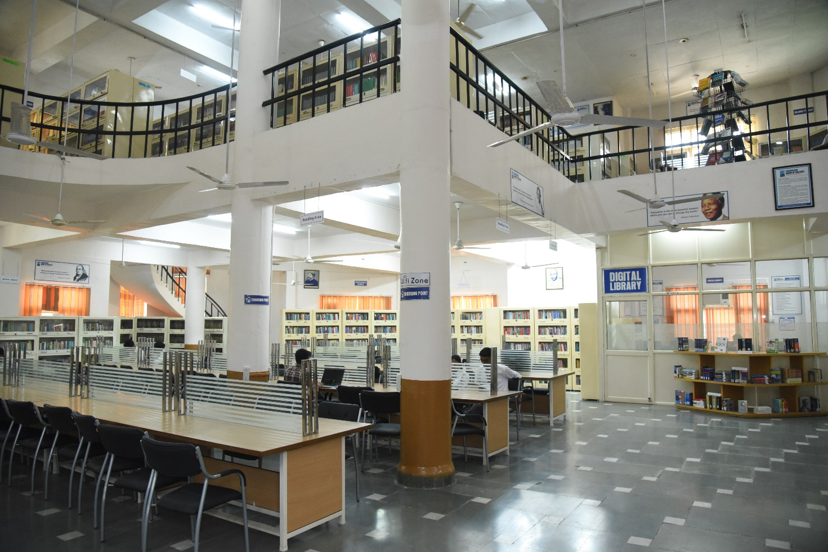
The online library provides live access to CHANDIGARH ENGINEERING COLLEGE LIBRARY Collection on institution website http://cgc.edu.in/. Students and Faculty can get online information about Books/CD’s/E Books/ Journals/ E journals dealing with various subjects. Library works on LIBSYS software. The library has 9 CCTV’s cameras to keep a close watch on the users to minimize the losses and mutilation of reading material.

Slide 3
LIBRARY TIMINGS
Normal Working Days
09:00 am to 7:00 pm
Examination Days
09:00 am to 9:00 pm

Slide 4
MISSION
The College Libraries are to sustain a physically and virtually appealing environment that promotes learning, teaching and research. It fosters lifelong intellectual growth and self-fulfilment by providing all users with versatile accessibility of the needed information resources. It also stimulates to promote individual sharing of ideas and love of reading and social enlightenment, enrichment throughout the knowledge society. It also supports in excellence and innovation in education and research.

Slide 5
OBJECTIVES
1) To establish a readers’ community to strengthen the goals.
2)To organize orientation programmes for users to keep them aware of the information society.
3) To promote the values and skills amongst the students.
4)To maintain a balanced and organized collection of high-quality materials and provide professional assistance to all users.
5) To provide access to information located elsewhere.
6)To educate users in developing information-gathering skills, including accessing, evaluating, and using various information sources.
7)To promote technological competence by providing access to information available in non-print formats.

Slide 6
LIBRARY AT A GLANCE
TOTAL COLLECTION OF BOOKS | 49062
NO. OF TITLES | 9632
REFERENCE & GENERAL BOOKS | 2547
RARE BOOKS | 101
BOOK BANK | 956
PRINT JOURNALS | 64
BOUND VOLS. OF PREVIOUS YEARS | 1199
NEWSPAPERS | 21
MAGAZINES | 21

Slide 7
LIBRARY STATISTICS
TOTAL MEMBERSHIP
4500
400
150
DAILY FOOTFALL
DAILY TRANSACTIONS

Slide 8
Library Committee
Functions | Composition | Names Of Faculty/Staff | Frequency of Meeting | Attendance
-To purchase books and learning resource material. | Chairman | Dr. Rajdeep Singh, Director-Principal | Minimum 1 per semester | Minimum 75%
-To collect, organize and disseminate print and electronic information to the academic community of the Institution and support the research activity of the Institution and to act as Learning Resource Centre. | Member Secretary | Ms. Renu Oberoi, Chief Librarian
 | Members | Dr. Pardeep Singh Tiwana, Associate Professor, IT
 |  | Ms. Parneet Kaur, Assistant Professor- CSE
 |  | Ms. Preeti Bansal, Assistant Professor - ECE
 |  | Dr. Satish Kumar, Associate Professor- ME
 |  | Dr. Sham, Associate Professor-Applied Sciences
 |  | Mr.Navneet Katoch,Assistant Professor- MCA
 |  | Ms.Ruhani Mahajan,Assistant Professor- MBA

Slide 9
CEC LIBRARY STAFF
NAME | DESIGNATION
RENU OBEROI | CHIEF LIBRARIAN
SAPNA SHARMA | LIBRARIAN
SUKHWINDER KAUR | ASSISTANT LIBRARIAN
SHIVANI JASWAL | ASSISTANT LIBRARIAN
KUSUM SHARMA | ASSISTANT LIBRARIAN
NARESH KUMAR | LIBRARY ASSISTANT
JANG SINGH | LIBRARY ASSISTANT
MUKESH KUMAR | LIBRARY ASSISTANT
KAMLESH KUMARI | LIBRARY RESTORER
PRITPAL | LIBRARY RESTORER

Slide 10

COLLEGE WEBSITE http://cecmohali.org/ LIBRARY SOFTWARE LIBSYS

Slide 11
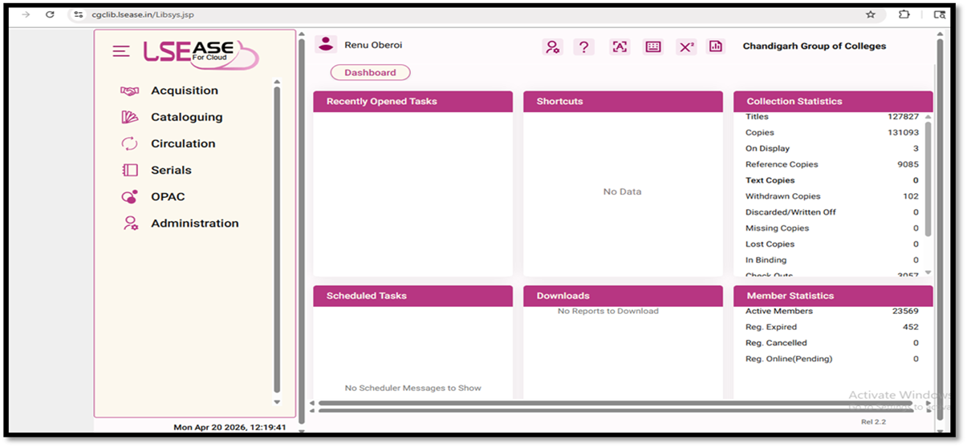
LIBRARY AUTOMATION USING INTEGRATED LIBRARY MANAGEMENT SYSTEM (ILMS) LIBRARY SOFTWARE INTERFACE
Works on Cloud
URL : http://cgclib.lsease.in/
WEBOPAC with Remote Access
URL : http://cgcopac.lsease.in/

Slide 12
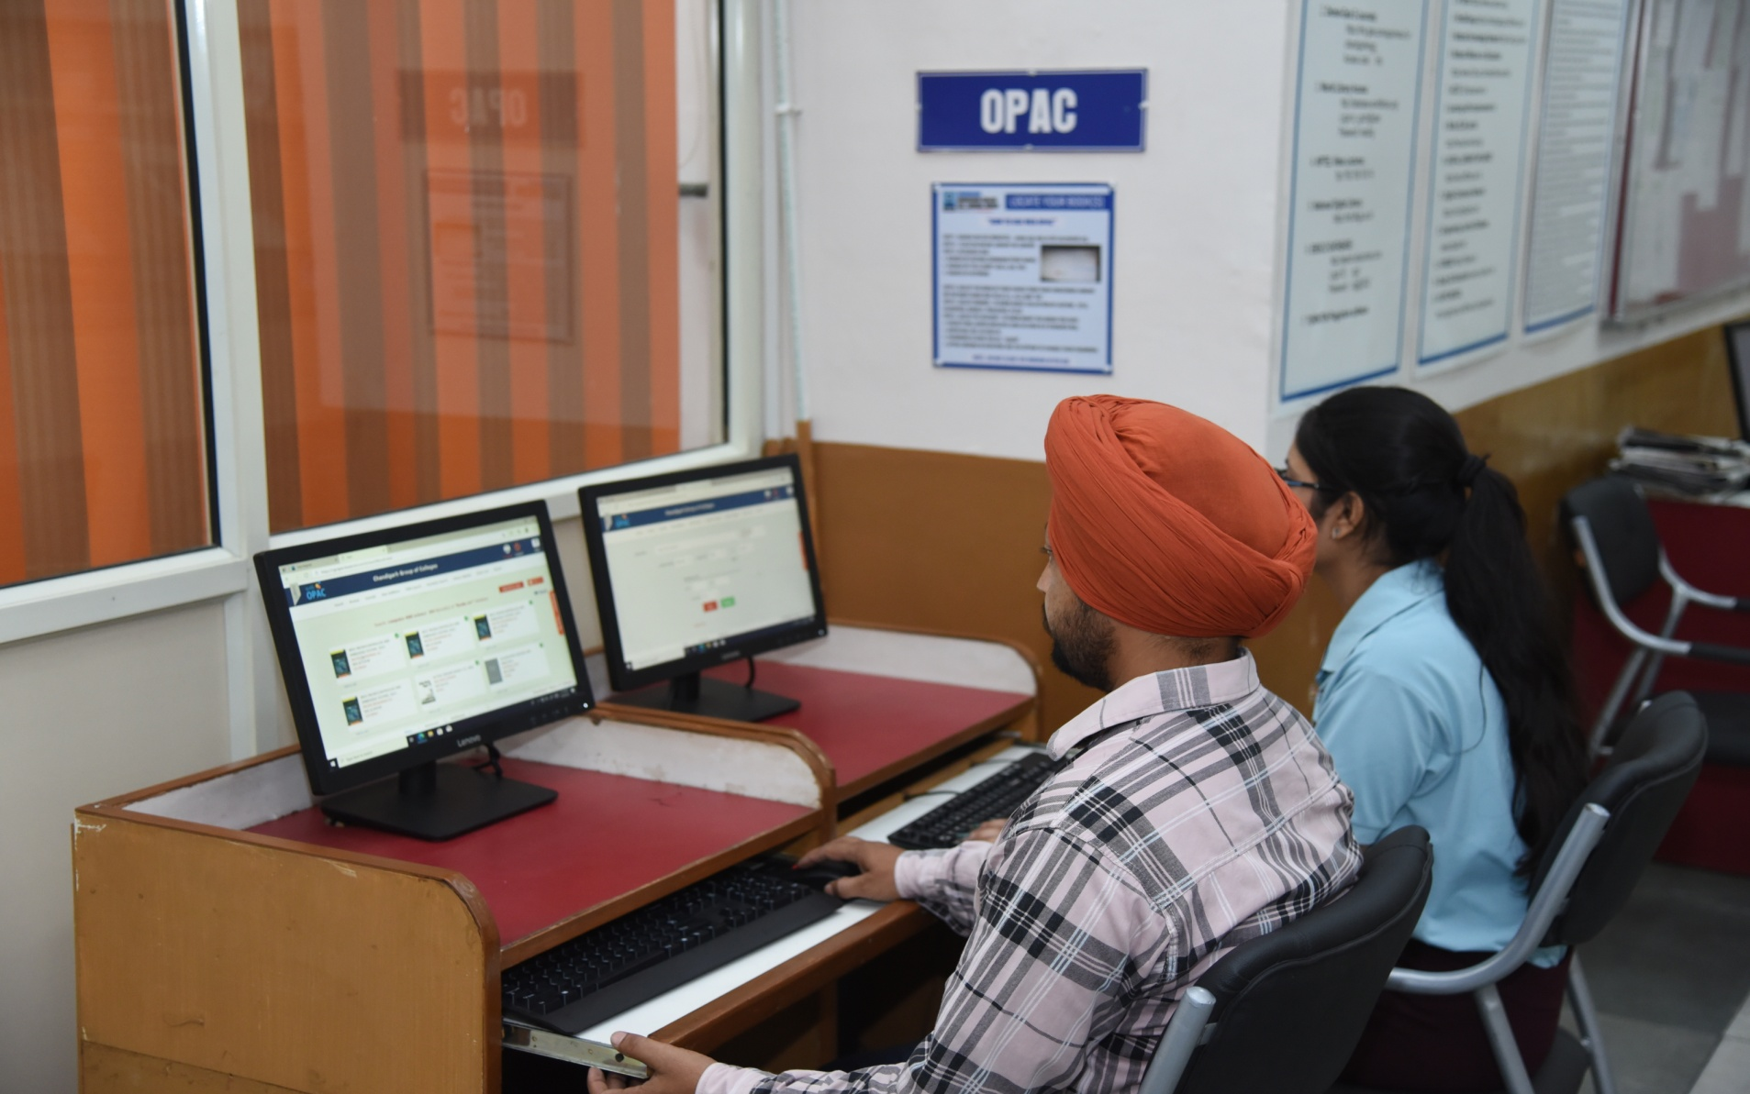
LIBRARY WEBOPAC

Slide 13
LOCATE YOUR BOOK(S) “HOW TO USE WEB OPAC” STEP 1 : SEARCH ON CGC WEBSITES:- www.cgc.edu.in OR cecmohali.org . STEP 2 : CLICK ON ONLINE LIBRARY OR LIBRARY. STEP 3 : IN THE SEARCH BAR : SEARCH BY AUTHOR (SURNAME/FIRST NAME) SEARCH BY TITLE (DON’T USE A, AN, THE) SEARCH BY KEYWORD STEP 4 : SELECT THE BOOK OF YOUR CHOICE FROM YOUR CONCERNED LIBRARY ON THE RIGHT-HAND SIDE FIELD (i.e., ALL) AND “GO”. STEP 5 : SELECT BROWSE: TO KNOW ABOUT COLLECTION BY AUTHOR, TITLE, CLASSIFIED, SUBJECT, PUBLISHER, PLACE. STEP 6 : SELECT MY ACCOUNT: TO KNOW ABOUT THE BOOKS YOU HAVE FACULTY WILL ENTER EMPLOYEE CODE AS USER ID & STUDENTS WILL ENTER ROLL NO. AS USER ID. PASSWORD IS SAME FOR ALL “cgclib”. AFTER LOGGING IN EVERYONE HAS THE OPTION TO CHANGE THEIR PASSWORD. NOTE : DO NOT CLOSE THE WINDOW AFTER USE

Slide 14


Slide 15

E RESOURCES Number of e-books (WORLD E-BOOK LIBRARY) 20 Lacs+ Number of e-books (EBSCO) 2,49,000 NDL Membership E-BOOKs 45 Lacs+ Number of e-journals(DELNET) 1550 Engg. e-journals(EBSCO) 3000+ Business Source Elite ( EBSCO) 1056 NPTEL VIDEO LECTURES 2203 CDs ( of Books and Magazines) 1200 TURNITIN Plagiarism Software

Slide 17
E-RESOURCES --- LOGIN CREDENTIALS
1. DELNET : http://www.delnet.in
Click to New Discovery Portal
Login : pbcecm
Password : cecm8478
2. WORLD LIBRARY ACCESS : http://database.worldlibrary.org/
Login : in_cgclm@user
Password : reading
3. DELNET-GALE E-JOURNALS : https://link.gale.com/apps/menu?u=chandigarhengg
Access code : info
4. EBSCO BUSINESS SOURCE ELITE : https://search.ebscohost.com/login.aspx?authtype=ip,uid&custid=ns154387&groupid=main&profile=ehost&defaultdb=bsh
User ID: chandigarhbusi
Password: Library@2025
5. EBSCO DATABASE : http://search.ebscohost.com
Login ID cgcl
Password clg@2022
NPTEL VIDEO LECTURES : ftp://192.168.100.14
7. NATIONAL DIGITAL LIBRARY : https://ndl.iitkgp.ac.in/
8. TURNITIN PLAGIARISM SOFTWARE : https://www.turnitin.com/login_page.asp?lang=en_us
9. LIBSYS WEBOPAC : cgcopac.lsease.in

Slide 18

The library has subscription of DELNET database via link http://www.delnet.in since the year 2013 and is subscribing e-journals and e-books through World e-book library via link http://database.worldlibrary.org/ and Gale journals via URL https://link.gale.com/apps/menu?u=chandigarhengg

Slide 19

EBSCO DATABASE EBSCO resources can also be remotely accessed on EBSCO App. or on the link http://search.ebscohost.com. It provides scholarly 3000 e-journals, working papers, reports, and datasets, and millions of digitized historical primary sources, including 2,49,000 e-books.

Slide 20
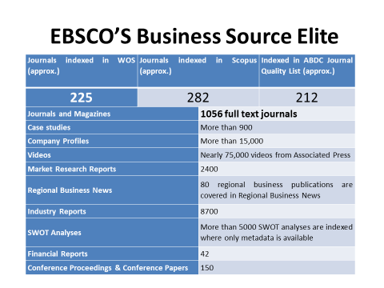

Slide 21

ANTI-PLAGIARISM SOFTWARE To promote and support the research activities, CEC -CGC as a remedial measure has provided access to anti-plagiarism software TURNITIN since 2020.It is one such software, which is being successfully used at the global level to cross-check a vast database for identifying plagiarized portions in one’s research.

Slide 22

Lakhs of e-books can be accessed through NDL via link http://ndl.iitkgp.ac.in//. INSTITUTIONAL NDL MEMBERSHIP NUMBER :INPBNC3ADJJC9BP

Slide 23

NPTEL Video lectures Stream wise NPTEL 2203 video lectures can be accessed via FTP LINK - ftp://192.168.100.14

Slide 24

Repository Links 1 e-PG Pathshala https://epgp.inflibnet.ac.in 2 e-Shodh Sindhu https://ess.inflibnet.ac.in 3 Search Engine for PDF Books www.pdfdrive.com 4 National Digital Library of India https://ndl.iitkgp.ac.in 5 ShodhGanga https://shodhganga.inflibnet.ac.in/ 6 Discover scientific knowledge and stay connected to the world of science https://www.researchgate.net/ 7 Free e books(60000+)https://www.gutenberg.org/ 8 NPTEL [National Programme on Technology Enhanced Learning] https://nptel.ac.in 9 NPTEL Video Lectures https://archive.nptel.ac.in/

Slide 25
10 OASIS (Openly Available Sources Integrated Search) https://openlibrary.org/ 11 Open access for academic books https://www.oapen.org/ 12 SAKSHAT https://sakshat.ac.in/?project=vidwan 13 Science, Health, Medical and Engineering Journals www.sciencedirect.com 14 Open Access books https://www.doabooks.org/ 15 SWAYAMPRABHA https://www.swayamprabha.gov.in 16 SWAYAM Online Courses https://storage.googleapis.com/uniquecourses/online.html 17 Engineering Research papers Database www.engpaper.com 18 Engineering and Applied Sciences Technology Journals www.ijeast.com 19 Enhancement in Learning with Improvement in Skills (ELIS) portal http://free.aicte-india.org/ 20 DOAB - Directory of Open Access Books https://directory.doabooks.org/handle/20.500.12854/34495

Slide 26
21 DOAJ https://doaj.org/ 22 e-Content courseware in UG subjects http://cec.nic.in/cec/ 23 E-Kalpa https://icar.org.in/content/e-kalpa 24 Open Access Books and Journals https://about.jstor.org/librarians/books/open-access-books-jstor/ 25 Free e-Books https://www.gutenberg.org/ 26 AICTE Collaborations (MoU) with other Organizations https://www.aicte-india.org/education/collaborations 27 AAKASH EDUCATIONAL PORTAL https://www.it.iitb.ac.in/nmeict/home.html 28 InfoPort https:/infoport.inflibnet.ac.in 29 National Educational Alliance for Technology https//neat.aicte-india.org/ 30 OAPEN https://www.oapen.org/

Slide 27
31 QUANTUM & NANO COMPUTING https://www.dei.ac.in/dei/quantumNano/ 32 The Online Books Page https://onlinebooks.library.upenn.edu/lists.html 33 SNLTR https://nltr.org 34 EThOS https://ethos.bl.uk/Home.do 35 DART-Europe E-theses Portal https://www.dart-europe.org/basic-search.php 36 Virtual Labs http://www.vlab.co.in/ 37 YOUTH4WORK https://www.youth4work.com/onlinetalenttest 38 Theses https://library-archives.canada.ca/eng 39 Gateway Accelerating Scientific Discovery https://worldwidescience.org/ 40 DIGITAL LIBRARY INFLIBNET https://ess.inflibnet.ac.in/

Slide 28
41 Digital Commons Network https://irsc.libguides.com 42 Engineering Journal Database researchgate.net 43 FOSSEE https://fossee.in 44 Study IQ Education www.youtube.com 45 UG/PG MOOC shttp://ugcmoocs.intlibnet.ac.in/ugemoocs 46 Engineering and technology Journal Database omicsonline.org 47 E-Books and E-Journalshttps://www.socsccybraryamu.ac.in/ 48 CEC-UGC YouTube Channelhttps://www.youtube.com/user/cecedusat 49 TCS iON Digital Glass Room https://learning.tcsionhub.in/hub/glass-room/ 50 RIChttps://eric.ed.gov/ 51 Free e-Databaseshttp://www.globethics.net/

Slide 29

52 Free Journalshttp://www.archive.org 53 Spoken Tutorialhttps:/spoken-tutorial.org/ 54 National Apprenticeship Training Scheme http://mhrdnats.gov.in/ 55 E – Kumbh https://ekumbh.aicte-india.org/ 56 E-BOOKS https://www.wikibooks.org/ 57 Social Science Research Network (SSRN) https://www.ssrn.com/

Slide 30

e-Newspaper WEBSITES
http://www.tribuneindia.com/
www.indianpress.org
www.hindustantimes.com/
www.epaper.timesofindia.com
www.epaper.dailypostindia.com
https://epaper.thehindu.com
http://economictimes.indiatimes.com/
http://epaper.amarujala.com/
www.epaper.jagran.com/
http://epaper.bhaskar.com/
http://epaper.aajsamaaj.com/
http://epaper.punjabkesari.in/
http://jagbani.epapr.in/
http://epaper.ajitjalandhar.com/
http://www.rozanaspokesman.com/epaper/

Slide 31

FREE E-MAGAZINE WEBSITES https://freemagazinepdf.com/ https://worldmags.net/ https://fliphtml5.com/ https://www.bisinfotech.com/bisinfotech-magazine https://pdf-magazines.org/ https://all-freemagazines.com/ https://downmagaz.net/ https://www.pdfmagaz.club/ https://magazinenewsstand.com/digital-magazines https://pdf-magazines-download.com/

Slide 32

FACILITIES PROVIDED BY LIBRARY

Slide 33
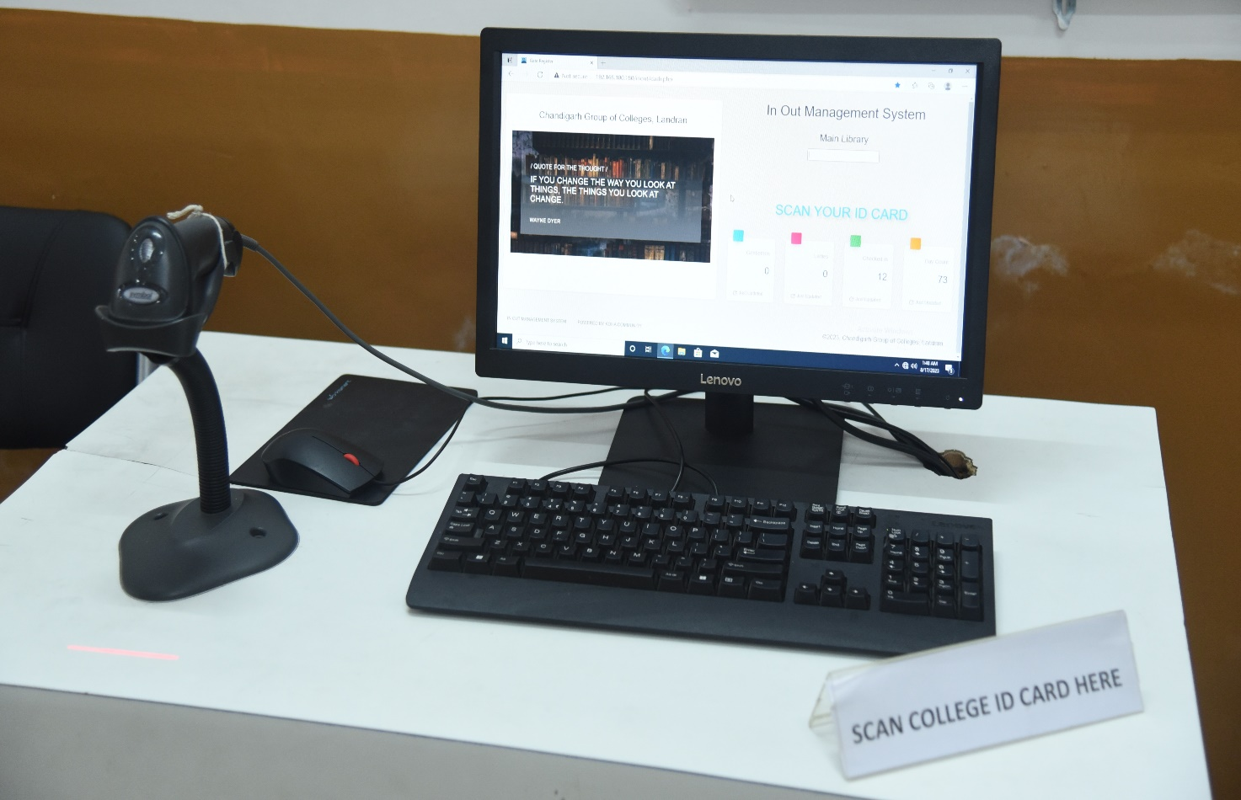
BARCODE SCANNED ENTRY/EXIT Since the ID cards are scanned to keep track of entry and exit, foot traffic in the library is computerized. Students scan their ID cards as they enter or leave the library using the barcode scanner for that.

Slide 34
CEC LIBRARY FOOTFALL INCLUDING APPLIED SC. LIBRARY
SR.NO | YEAR | TOTAL | TOTAL | TOTAL | GRAND TOTAL
 |  | MORNING TIMINGS | EXTENDED TIMINGS | DIGITAL LIBRARY
1 | 2021 TO 2022 | 21858 | 3674 | 4101 | 29633
2 | 2022 TO 2023 | 34468 | 3105 | 10997 | 48570
3 | 2023 TO 2024 | 52284 |  |  | 52284
4 | 2024 TO 2025 | 61034 |  |  | 61034
5 | 2025 TO 2026 (Till 22nd April) | 45867 |  |  | 45867

Slide 35
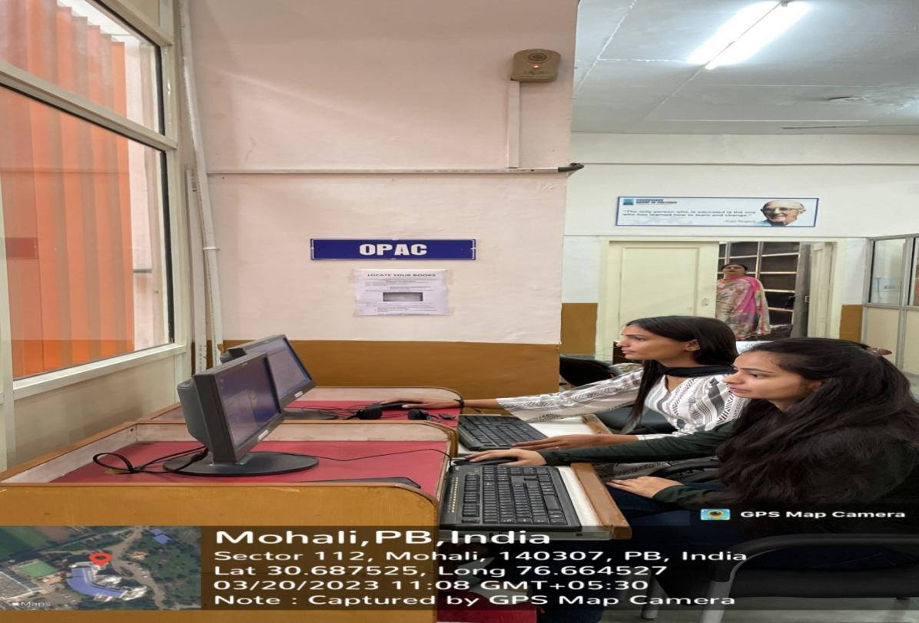
ONLINE CATALOGUE (OPAC) The facility to search the open public access catalogue (OPAC) is open to all the users over the campus-wide LAN at the URL: https://cgcopac.lsease.in/. 2 pcs in the library are exclusively dedicated to OPAC search to facilitate the users.

Slide 36
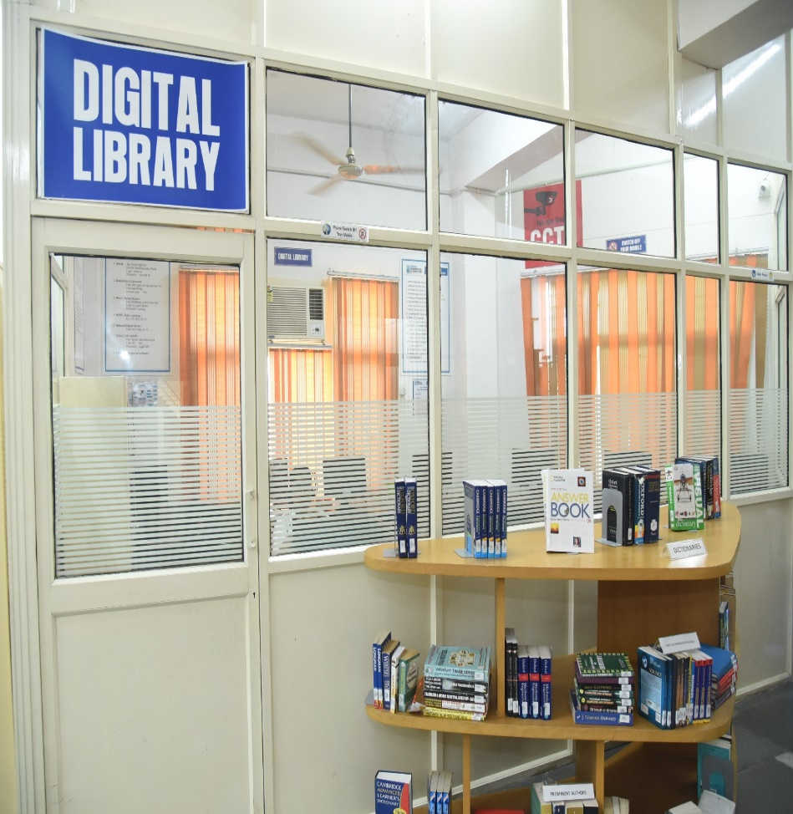
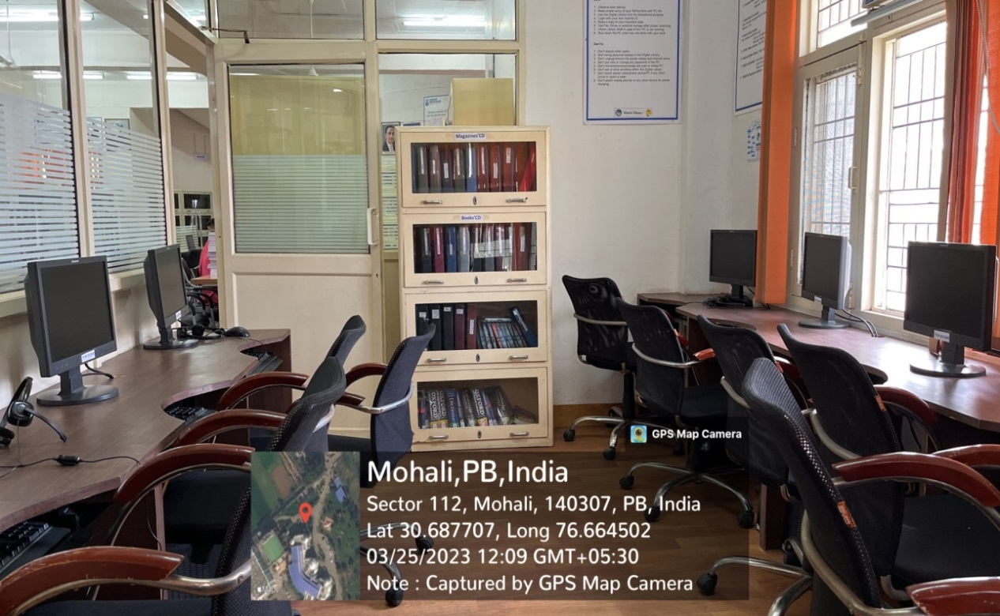
DIGITAL LIBRARY THE LIBRARY INTENDS TO HAVE A WELL-DEVELOPED COMPUTER AND NETWORK INFRASTRUCTURE IN THE FORM OF A DIGITAL LIBRARY WITH A PROVISION OF 20 COMPUTERS TO FACILITATE THE USE OF ALL THE WEB-BASED RESOURCES AND SERVICES SUBSCRIBED

Slide 37
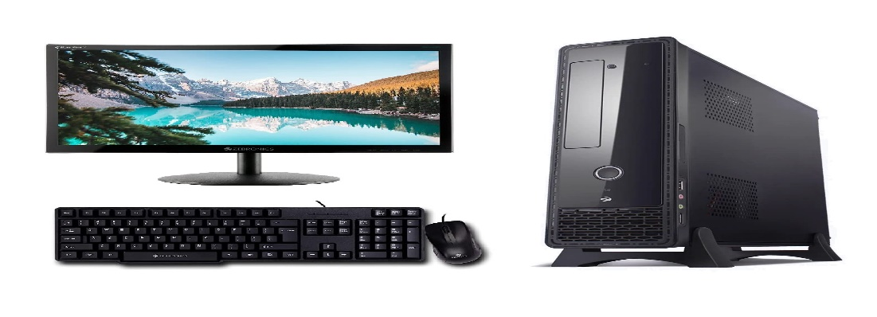
Detail of computer systems in CEC-CGC (Main & Departmental) libraries For students to study E resources
Computer systems in Main Library 20 nos.
ECE Departmental Library 8 nos.
ME Departmental Library 5 nos.
CSE Departmental Library 7 nos.
IT Departmental Library 10 nos. Applied Science Departmental Library 10 nos.

Slide 38
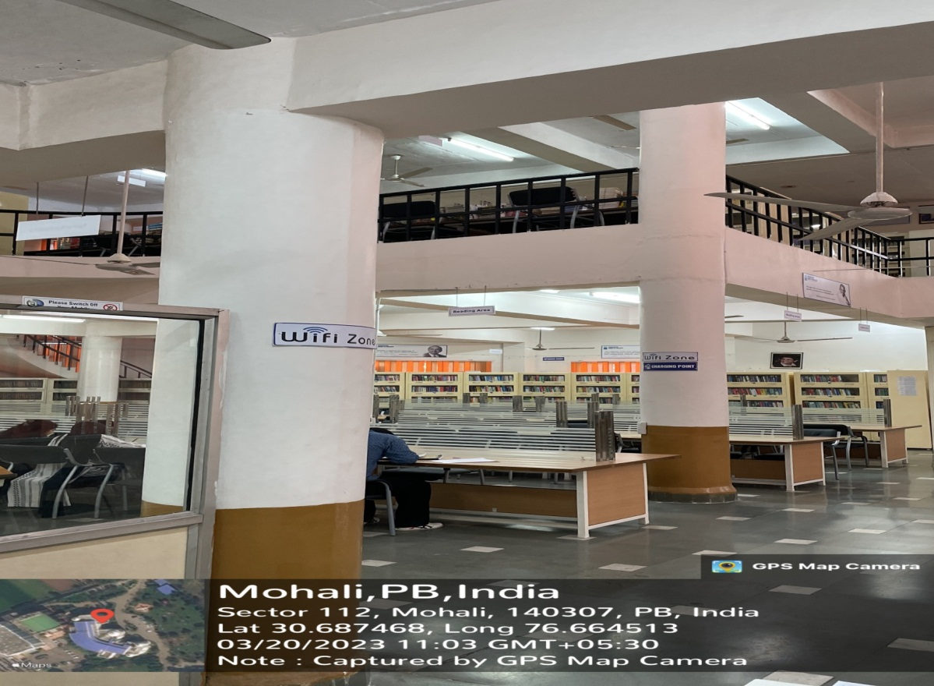
WI-FI FACILITY STUDENTS & FACULTY CAN ACCESS THE INTERNET WITHIN LIBRARY PREMISES ON THEIR LAPTOPS AND MOBILES AS THE LIBRARY IS WI-FI ENABLED.

Slide 39
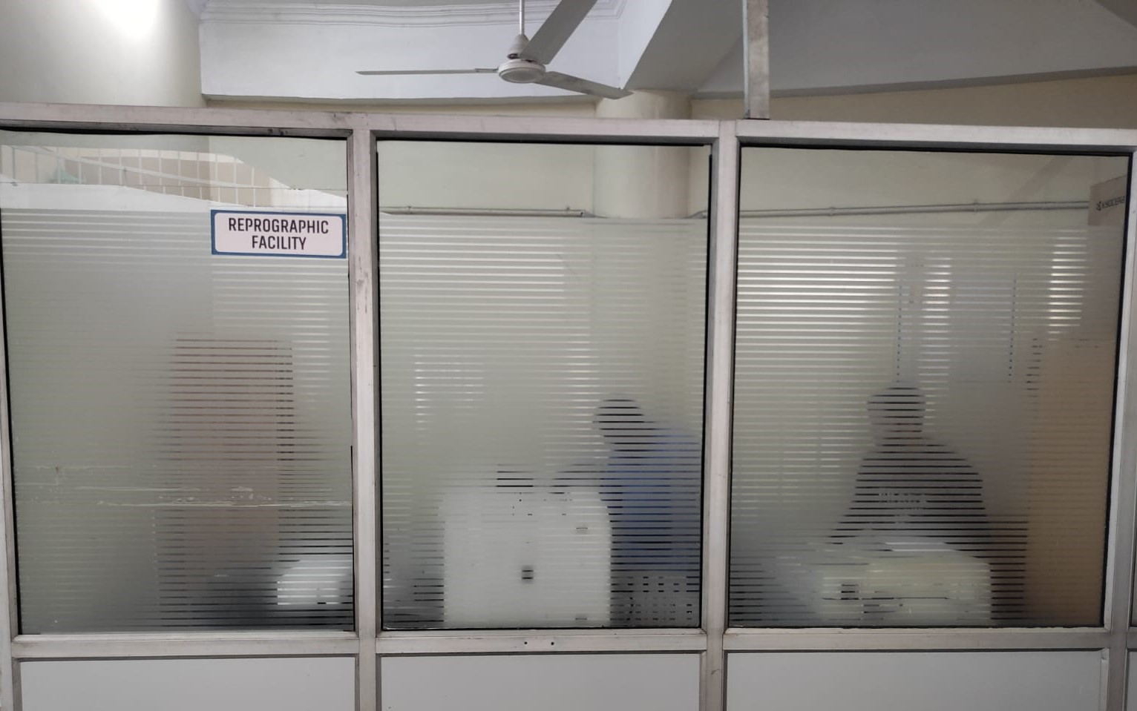
REPROGRAPHIC SERVICE THE LIBRARY FACILITATES ITS USERS BY PROVIDING REPROGRAPHIC SERVICE FOR GETTING THE REQUIRED MATERIAL PHOTOCOPIED. THE LIBRARY ALSO HAS A SCANNING FACILITY AVAILABLE WITHIN THE LIBRARY PREMISES.

Slide 40
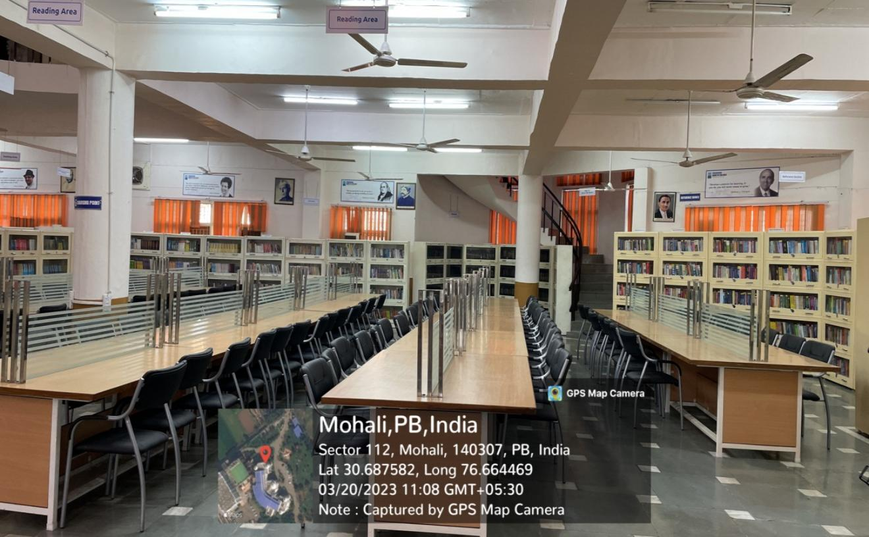
READING HALL FACILITY The library provides its users with a conducive atmosphere with ample seating capacity on the ground floor and the first floor.

Slide 41
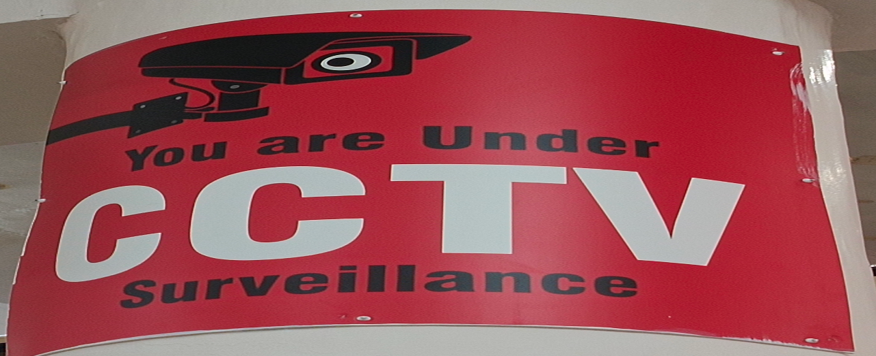
CCTVs in Main Library
9 CCTVs are installed in Main Library for 24hr. Surveillance

Slide 42
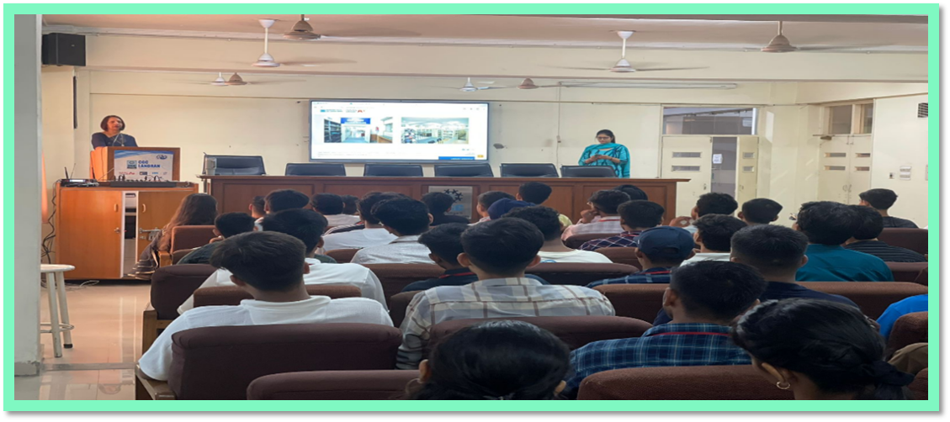
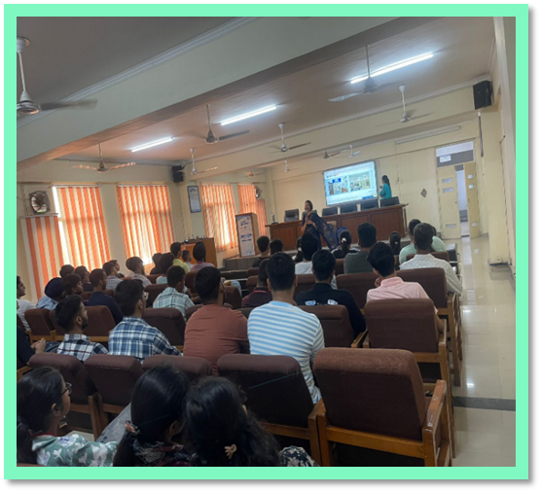
INDUCTION PROGRAMME FOR FRESHERS (SESSION 2025-2026)

Slide 43
STREAMWISE COLLECTION OF CEC LIBRARY

Slide 44
LOCATION OF BOOKS IN LIBRARY
SR NO. | BOOKCASE NO. | FLOOR | SUBJECT/STREAM
1 | I TO XIII | GROUND | REFERENCE SECTION
2 | 1 TO 12 | GROUND | MATHS
3 | 13 TO 50 | GROUND | ECE
4 | 51 TO 52 | GROUND | GENERAL BOOKS
5 | 53 TO 56 | GROUND | PHYSICS /CHEMISTRY
6 | C1 TO C4 | GROUND | COMPETITION BOOKS
7 | 57 TO 62 | GROUND | BOOK BANK
8 | 63 | GROUND | RARE BOOKS
9 | 64 | FIRST | ENVIRONMENT
10 | 65 TO 99 | FIRST | MECHANICAL
11 | 100 TO 153 | FIRST | COMPUTER
12 | 154 TO 172 | FIRST | PG COURSES
13 | 173 TO 175 | FIRST | ME

Slide 45
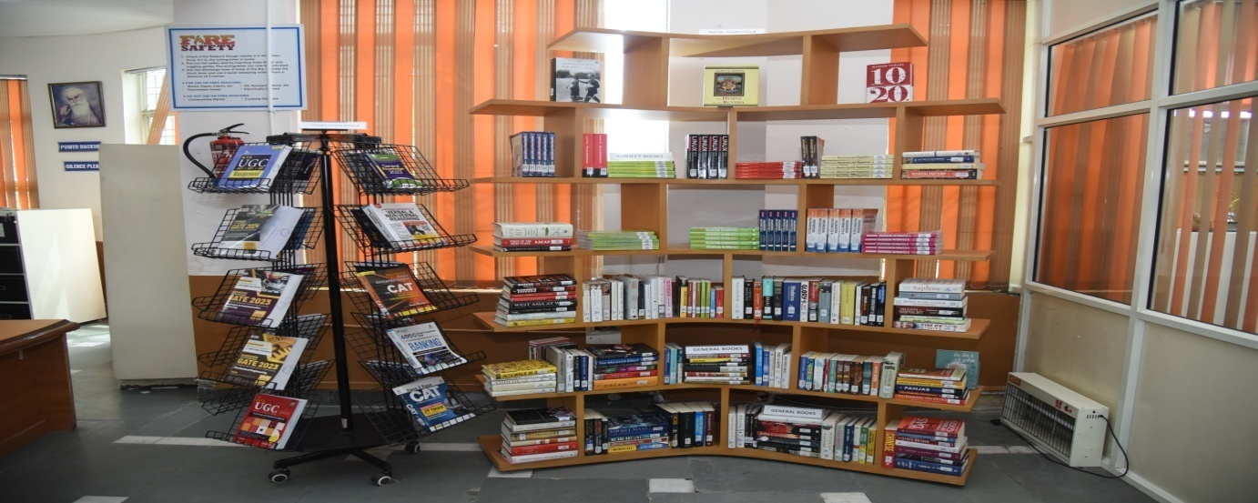
DISPLAY OF NEW ARRIVALS

Slide 46
NEW ARRIVALS – YEAR 2025-26
ACCESSION NUMBER | CALL NO. | TITLE | AUTHOR | COPIES
EC42088-EC42097 | 510 N237S | SPECTRUM DISCRETE MATHEMATICS | NARULA,RAJESH KUMAR | 10
EC42098-EC42107 | 004.22 S782C | COMPUTER ORGANIZATION AND ARCHITECTURE | STALLINGS,WILLIAM | 10
EC42108-EC42111 | 030 M181G | GATE 2026 : COMPUTER SCIENCE AND INFORMATION TECHNOLOGY | MADE EASY PUBLICATIONS | 4
EC42112-EC42117 | 004.6782 E69C | CLOUD COMPUTING | ERL,THOMAS | 6
EC42118-EC42122 | 170 G273F | FOUNDATION COURSE IN HUMAN VALUES AND PROFESSIONAL ETHICS | GAUR,R.R. | 5
EC42123 | 005.133 N147P | PROFESSIONAL C # AND . NET | NAGEL, CHRISTIAN | 1
EC42124-EC42163 | 515.15 T454C | CALCULUS AND ANALYTIC GEOMETRY | THOMAS,G. B. AND FINNERY,ROSS L. | 40
EC42164-EC42168 | 030 A266O | OBJECTIVE GENERAL ENGLISH | AGGARWAL,R.S. | 5
EC42169-EC42193 | 005.133 S531P | PROGRAMMING IN PYTHON | SHARMA,POOJA | 25
EC42194-EC42203 | 005.133 R214C | CORE PYTHON PROGRAMMING | RAO,NAGESWARA R. | 10
EC42204-EC42208 | 006.3 R961A | ARTIFICIAL INTELLIGENCE : MODERN APPROACH | RUSSELL,STUART | 5
EC42209-EC42210 | 005.13 L255R | R FOR EVERYONE | LANDER,JARED P. | 2
EC42211-EC42220 | 004.22 M285C | COMPUTER SYSTEM ARCHITECTURE | MANO,MORRIS M. | 10

Slide 47
EC42221-EC42222 | 005.43 S582O | OPERATING SYSTEM CONCEPTS | SILBERSCHATZ,ABRAHAM | 2
EC42223-EC42224 | 005.13 C811I | INTRODUCTION TO ALGORITHMS | COREMEN,THOMAS H. | 2
EC42225-EC42227 | 005 G577C | CYBER SECURITY | GODBOLE,NINA AND BELAPURE,SUMIT | 3
EC42228 | 006.31 G377H | HANDS ON MACHINE LEARNING WITH SCIKIT-LEARN, KERAS, AND TENSORFLOW | GERON,AUSCLIEN | 1
EC42229-EC42238 | 170 G273F | FOUNDATION COURSE IN HUMAN VALUES AND PROFESSIONAL ETHICS | GAUR,RR | 10
EC42239-EC42243 | 005.8 S782C | CRYPTOGRAPHY AND NETWORK SECURITY | STALLINGS,WILLIAM | 5
EC42244-EC42248 | 004.678 H874S | SECURITY AND PRIVACY IN INTERNET OF THINGS | HU,FEI | 5
EC42249-EC42253 | 006.312 L879B | BIG DATA ANALYTICS | LOSHIN,DAVID | 5
EC42254 | 823 M972N | NORWEGIAN WOOD | MURAKAMI,HARUKI | 1
EC42255 | 823 G464B | BIG MAGIC : CREATIVE LIVING BEYOND FEAR | GILBERT,ELIZABETH | 1
EC42256 | 823 E97I | INDISTRACTABLE : HOW TO CONTROL YOUR ATTENTION AND CHOOSE YOUR LIFE | EYAL,NIR | 1
EC42257 | 616.079 M468M | MIND-GUT-IMMUNE CONNECTION | MAYER,EMERAN | 1
EC42258 | 813.54 C456Y | YOU ONLY LIVE ONCE | CHANGLE,STUTI | 1
EC42259 | 823 K21F | FIRST 20 HOURS | KAUFMAN,JOSH | 1
EC42260 | 158.1 P781H | HOW TO SOLVE IT | POLYA,GEORGE | 1
EC42261 | 158.1 K62W | WHY 'A' STUDENTS WORK FOR C STUDENTS AND 'B' STUDENTS WORK FOR THE GOVERNMENT | KIYOSAKI,ROBERT T. | 1
EC42262-EC42266 | 004.165 M745P | PROGRAMMING THE RASPBERRY PI (TM) | MONK,SIMON | 5

Slide 48

DIFFERENT SECTIONS OF LIBRARY
ENTRY/EXIT GATE
PROPERTY COUNTER
WEBOPAC SECTION
ACQUISITION SECTION
TECHNICAL SECTION
REFERENCE SECTION
RARE BOOK SECTION
CIRCULATION SECTION
PG COURSES SECTION
PERIODICAL SECTION
BOUND VOLUMES SECTION
BOOK BANK SECTION
DIGITAL LIBRARY SECTION
REPROGRAPHIC SECTION

Slide 49
ACQUISITION SECTION
NO.OF TITLES/VOLUMES ADDED- LAST 5 YEARS GROWTH
Session | Accession no. | No. of titles | No. of vol. | Expenditure in Rs.
2021-2022 | 39662-40342 | 122 | 681 | 404032.00
2022-2023 | 40343-41142 | 243 | 799 | 378054.00
2023-2024 | 41143-41574 | 65 | 431 | 265913.00
2024-2025 | 41575-41885 | 41 | 311 | 249307.00
2025-2026 | 41886-42266 | 53 | 381 | 313621.00

Slide 50
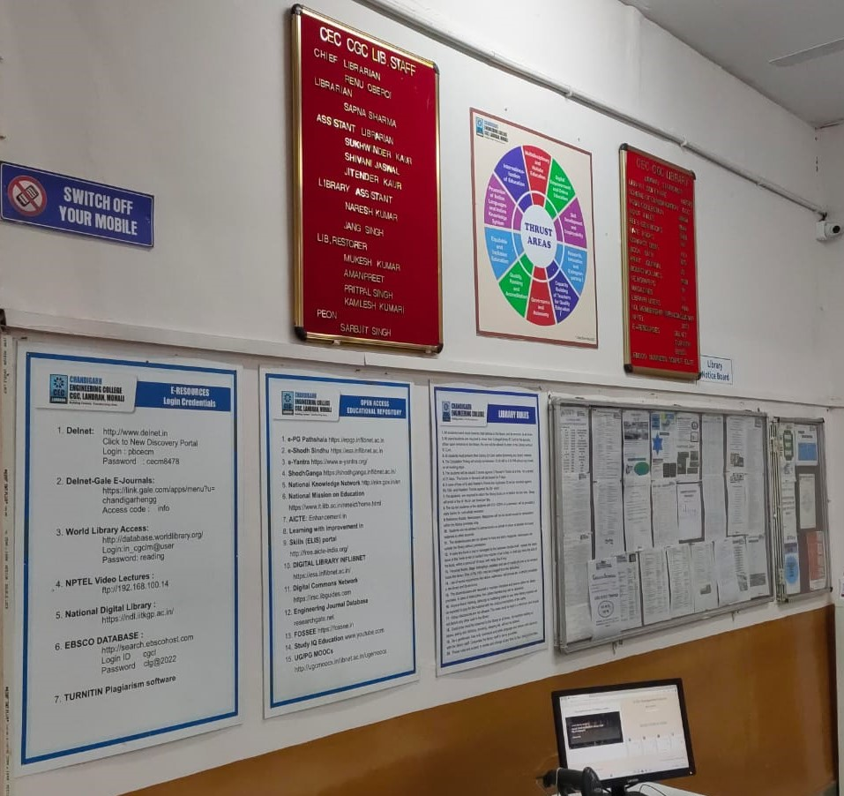
LIBRARY NOTICE BOARD

Slide 51
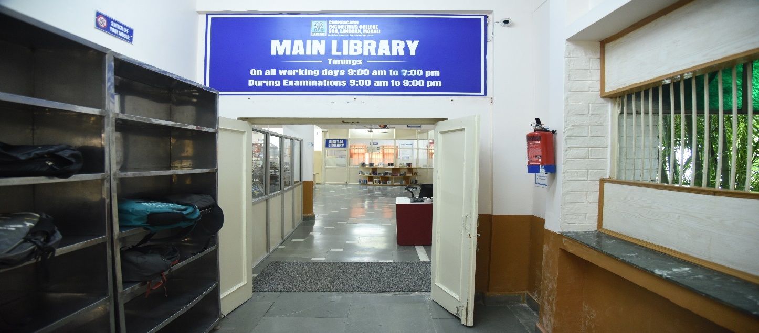
ENTRY / EXIT GATE

Slide 52
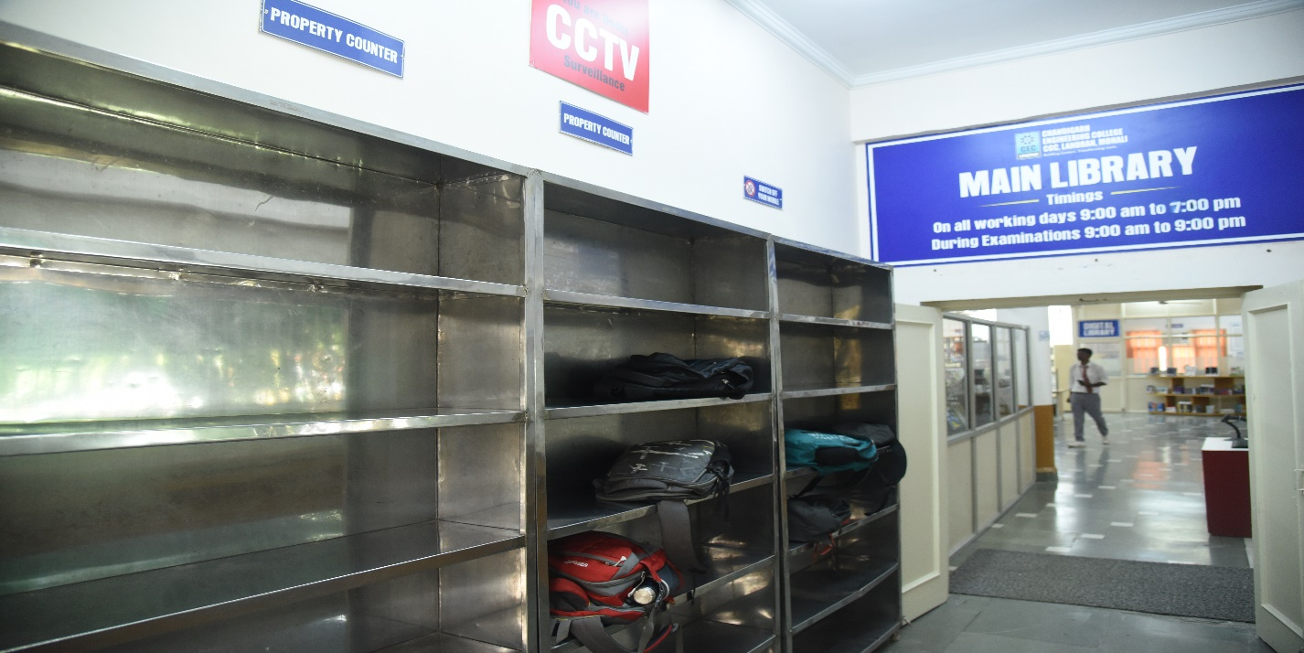
PROPERTY COUNTER

Slide 53
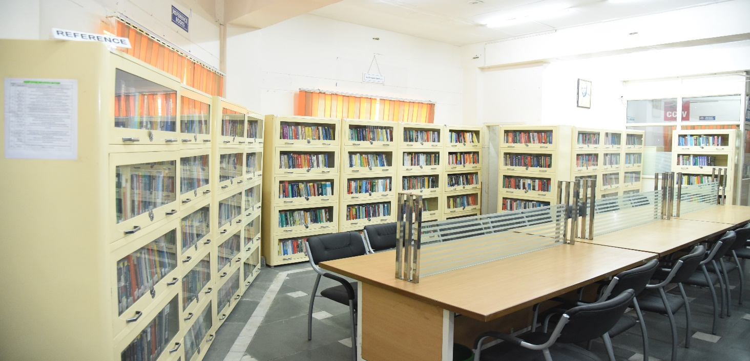
REFERENCE SECTION

Slide 54
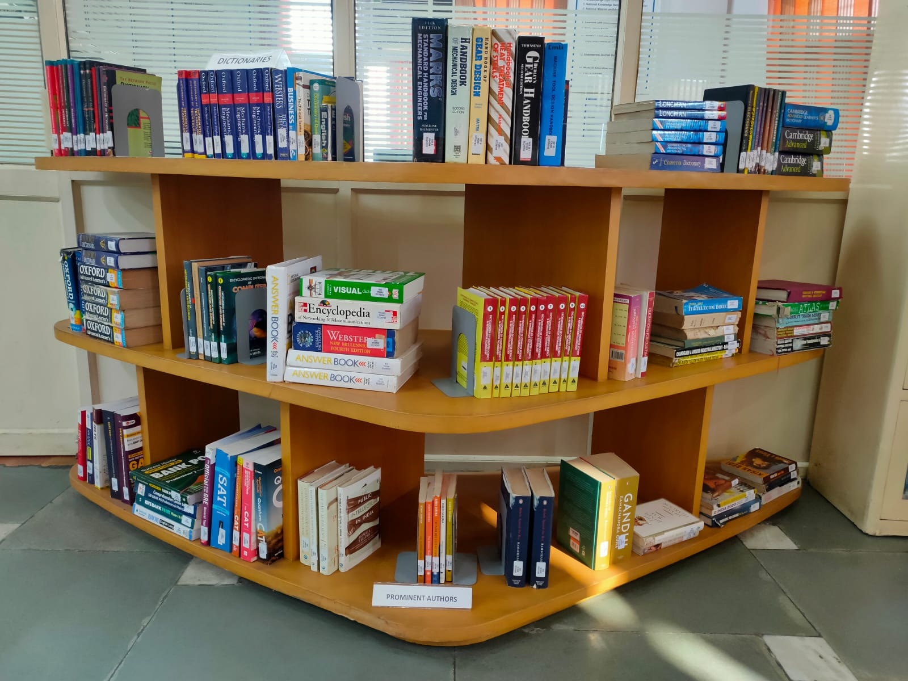
DISPLAY OF ENCYCLOPEDIA/ DICTIONARIES

Slide 55
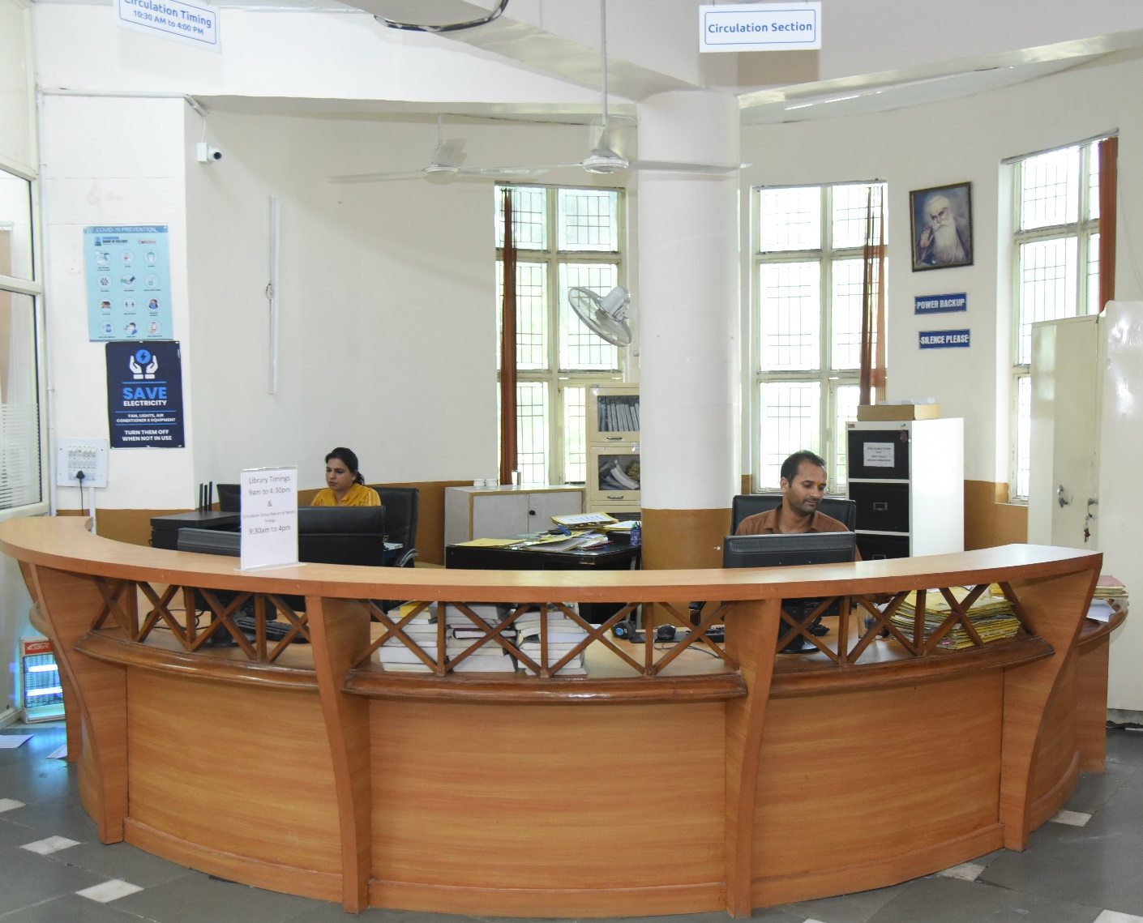
CIRCULATION SECTION

Slide 56
CIRCULATION SCHEDULE
NUMBER OF BOOKS ISSUED TO EACH STUDENT 3 BOOKS
PERIOD OF RETENTION 21 DAYS
MERITORIOUS/SC STUDENTS GET 2 BOOKS EXTRA
CIRCULATION TIMINGS
9:30 am to 4:30 pm
IMPORTANT: ALL THE STUDENTS GET CLEARED THEIR LIBRARY ACCOUNTS AT THE END OF EACH SEMESTER

Slide 57
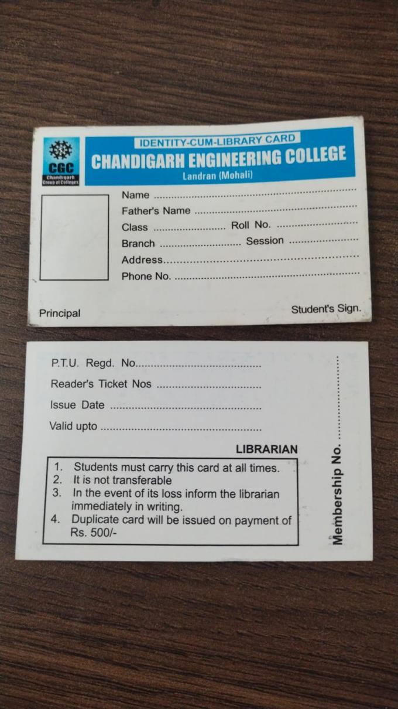
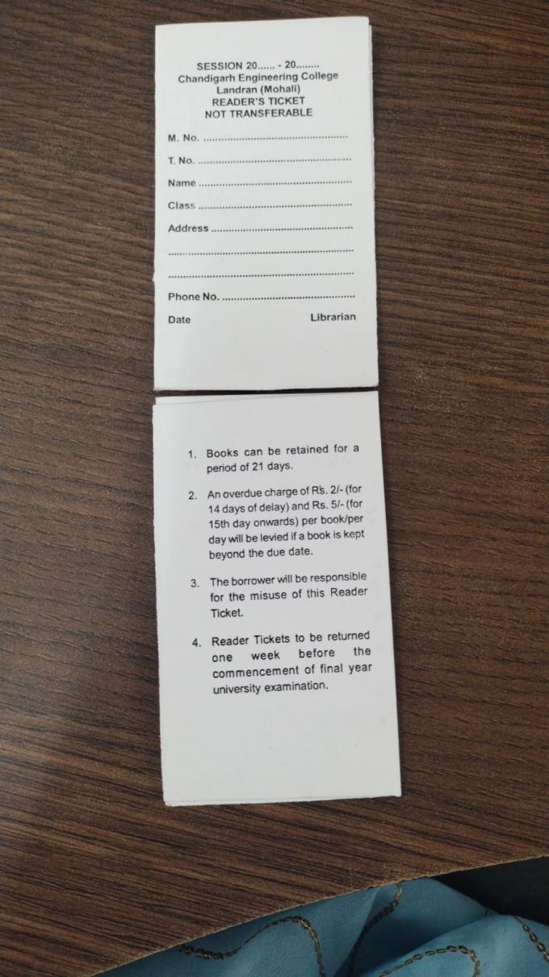
SPECIMEN : STUDENTS’ LIBRARY CARD AND TICKETS

Slide 58
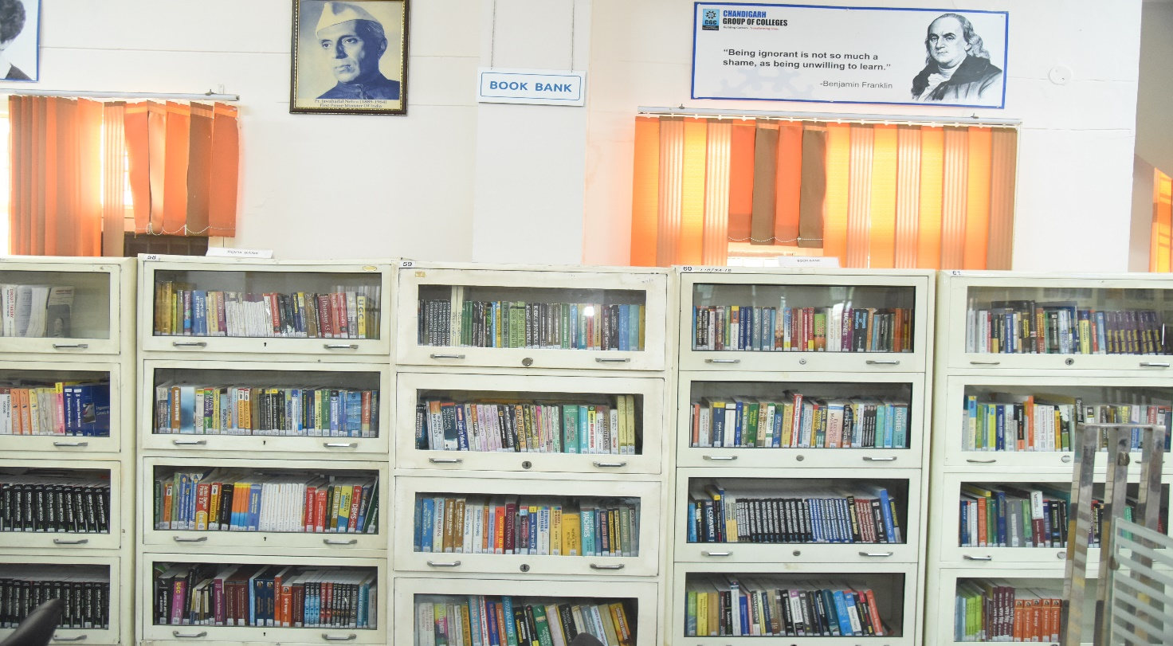
BOOK BANK SECTION

Slide 59
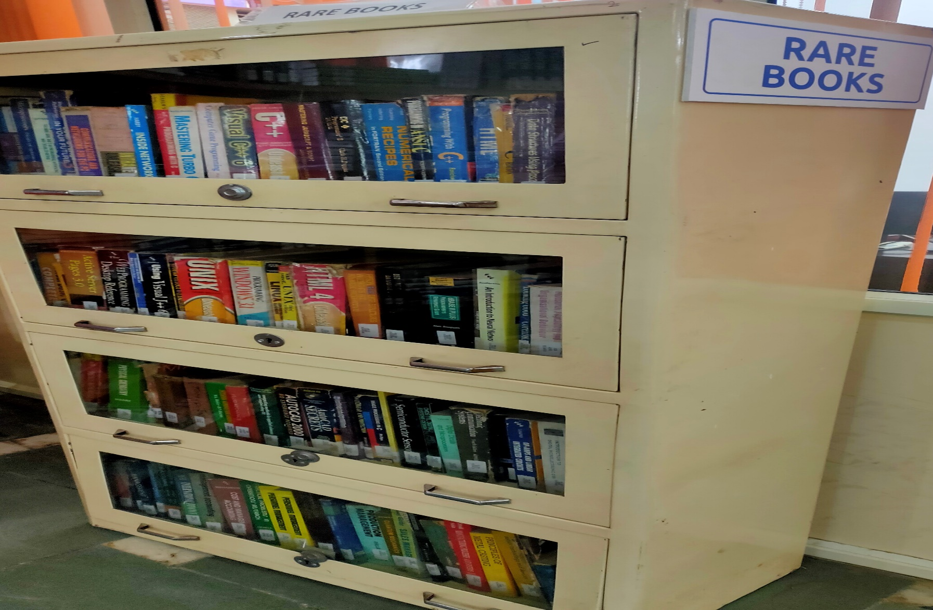
RARE BOOKS SECTION

Slide 60
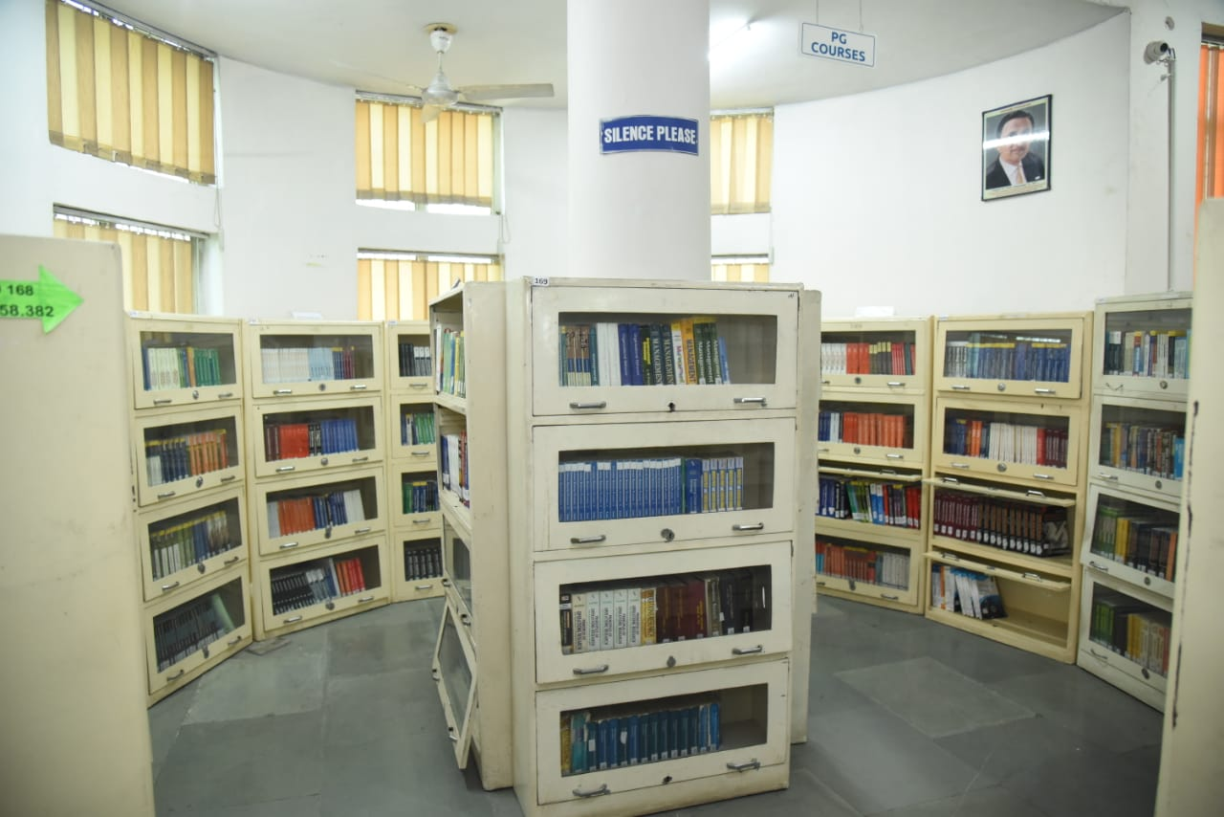
PG COURSES BOOKS SECTION

Slide 61
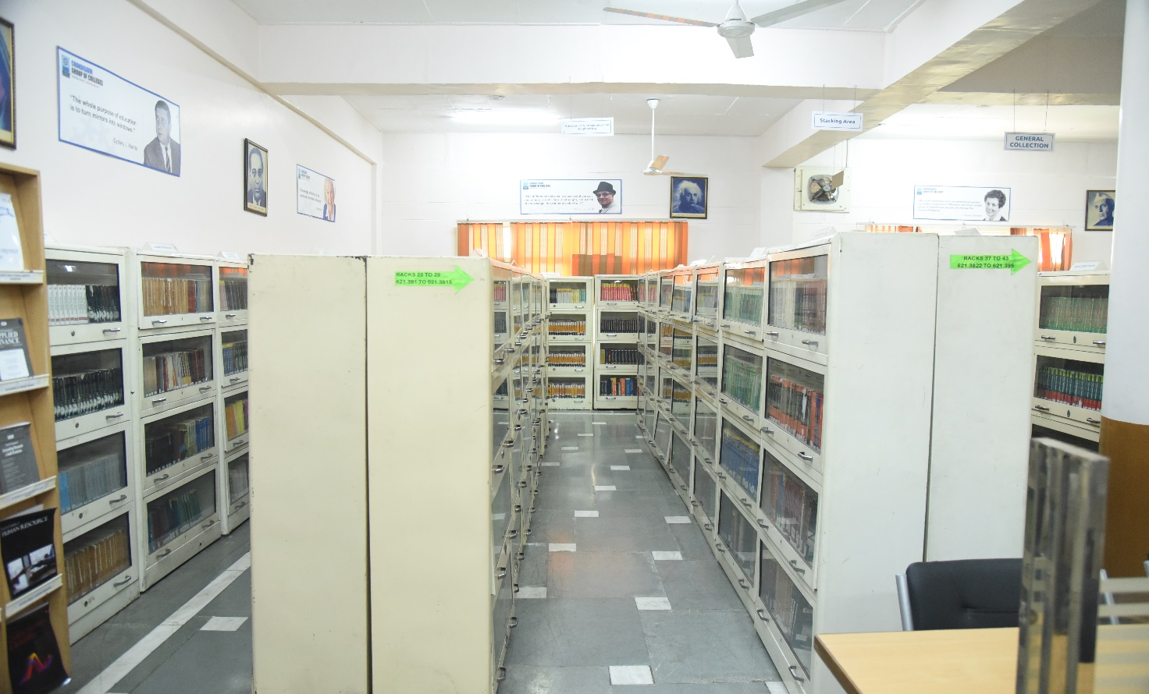
STACK AREA- GROUND FLOOR

Slide 62
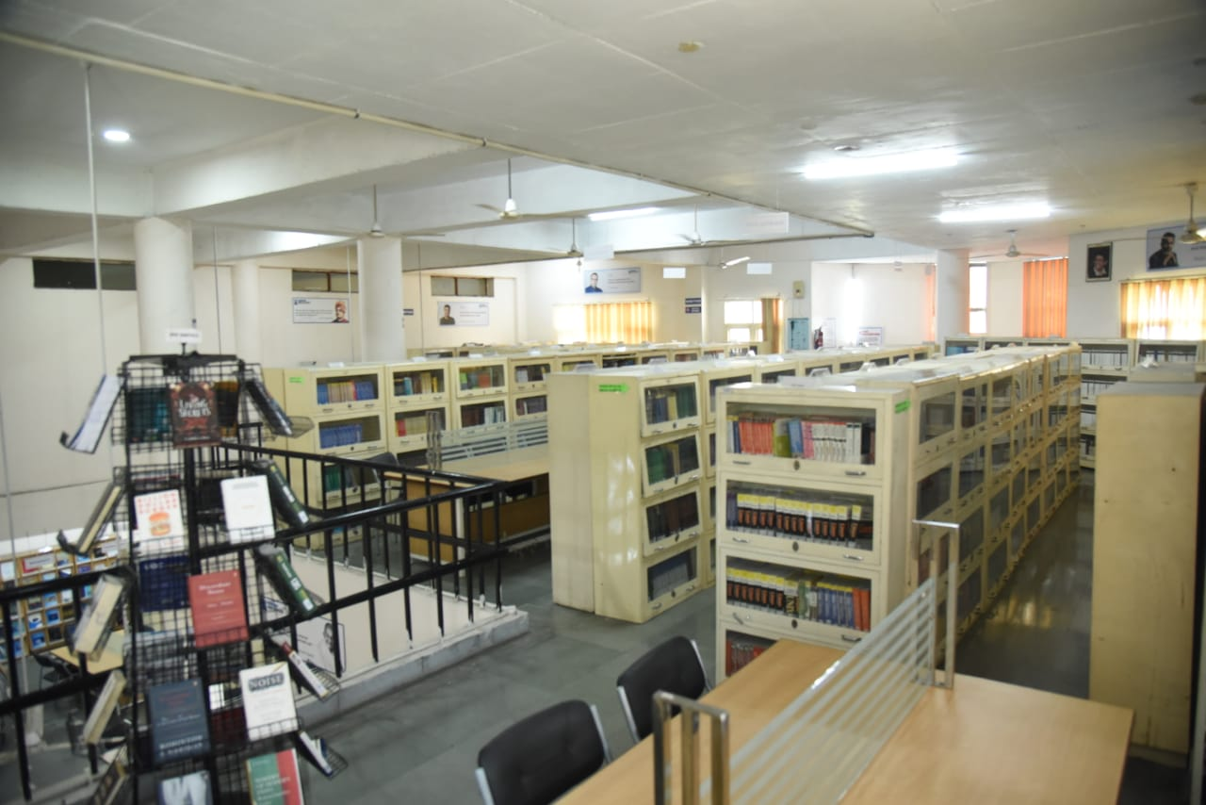
STACK AREA- FIRST FLOOR

Slide 63
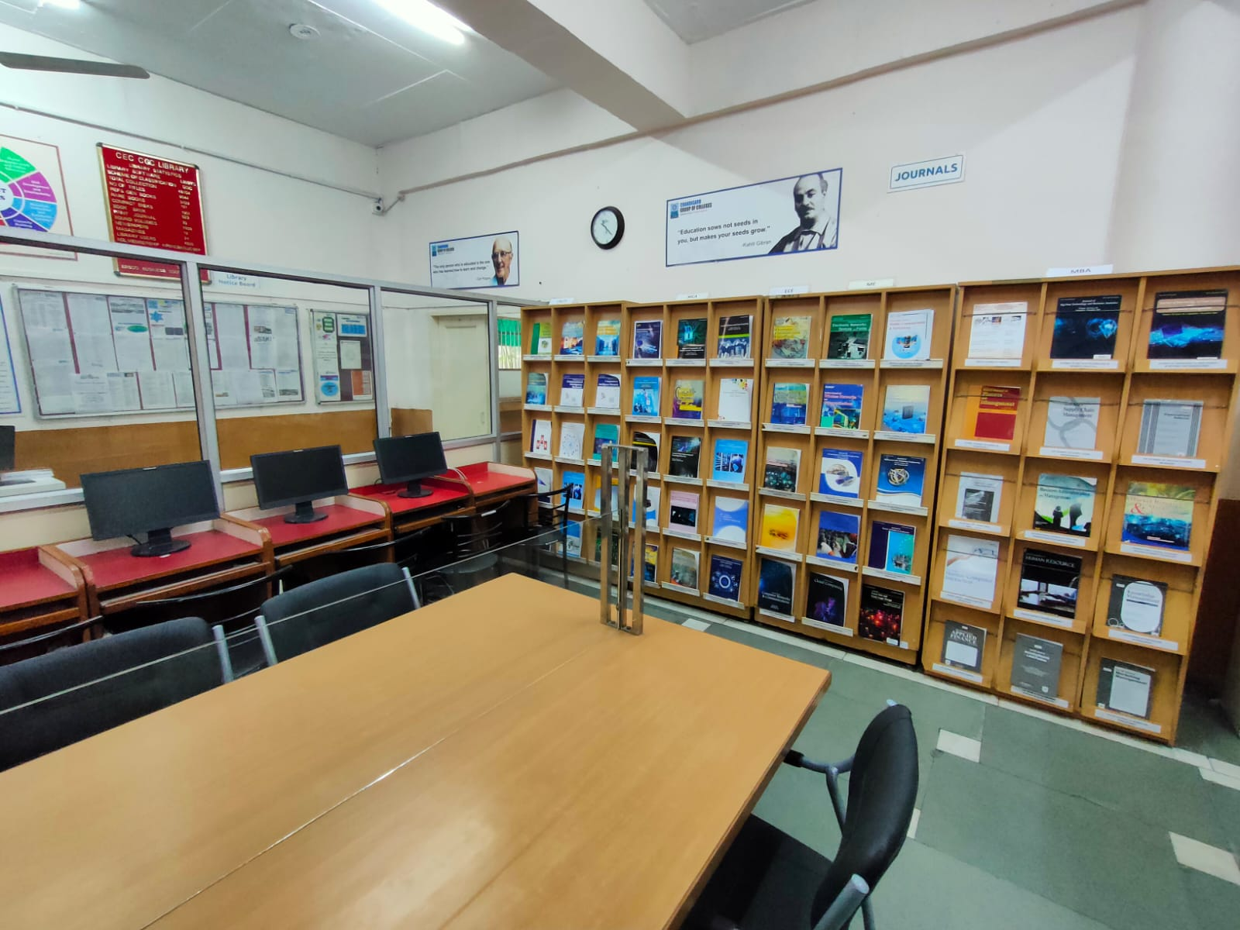
PERIODICAL SECTION
LIBRARY SUBSCRIBES TO 64 PRINT JOURNALS, 21 MAGAZINES AND 21 NEWSPAPERS

Slide 64
SUBSCRIBED PRINT JOURNALS – YEAR 2026
APPLIED SCIENCE
1 | GLOBAL JOURNAL OF PURE & APPLIED MATHEMATICS
2 | INTERNATIONAL JOURNAL OF PURE & APPLIED PHYSICS
3 | INTERNATIONAL JOURNAL OF APPLIED CHEMISTRY
ECE
4 | INTERNATIONAL JOURNAL OF ELECTRONICS & COMMUNICATION ENGG.
5 | INTERNATIONAL JOURNAL OF MOBILE COMMUNICATION & NETWORKING
6 | INTERNATIONAL JOURNAL OF ELECTRONIC NETWORK,DEVICES & FIELDS
7 | ADVANCES IN WIRELESS & MOBILE COMMUNICATION
8 | INDIAN JOURNAL OF DIGITAL ELECTRONIC TECHNOLOGIES
CSE & IT
9 | INTERNATIONAL JOURNAL OF ADVANCED SOFTWARE ENGINEERING
10 | INTERNATIONAL JOURNAL OF DATA MINING & DATA WAREHOUSE
11 | INTERNATIONAL JOURNAL OF COMPUTER & INTERNET SECURITY
12 | INTERNATIONAL JOURNAL OF COMPUTATIONAL INTELLIGENT RESEARCH
13 | INDIAN JOURNAL OF DIGITAL INFORMATION TECHNOLOGY
14 | JOURNAL OF COMPUTER SCIENCE ENGINEERING & SOFTWARE TESTING
15 | JOURNAL OF COMPUTER BASED PARALLEL PROGRAMMING
16 | INVENTI IMPACT COMPTER NETWORKS & COMMUNICATIONS
17 | INVENTI IMPACT:CLOUD COMPUTING

Slide 65
ME
18 | JOURNAL OF MECHANICAL & MECHANICS ENGINEERING
19 | JOURNAL OF ENVIRONMENT ENGINEERING & STUDIES
20 | INVENTI IMPACT MECHANICAL ENGINEERING
MBA
21 | INTERNATIONAL JOURNAL OF MARKET RESEARCH & MARKET TECHNOLOGY
22 | INTERNATIONAL JOURNAL OF BUSINESS ADMINISTRATION & MANAGEMENT
23 | INTERNATIONAL REVIEW OF BUSINESS & FINANCE
24 | INTERNATIONAL JOURNAL OF CUSTOMER RELATION MANAGEMENT
25 | INTERNATIONAL JOURNAL OF HUMAN RESOURCE MANAGEMENT
26 | IUPJOURNAL OF BANK MANAGMENT
27 | JOURNAL OF DIGITAL MARKETING
28 | IUP JOURNAL OF OPERATIONAL MANAGEMENT
29 | IUP JOURNAL OF ORGANIZATIONAL BEHAVIOR
30 | SCIENXT INTERNATIONAL JOURNAL OF RECENT TRENDS IN DIGITAL MARKETING
31 | GLOBAL JOURNAL OF FINANCE & MANAGEMENT
MCA
32 | JOURNAL OF COMPUTER SCIENCE & APPLICATIONS
33 | INTERNATIONAL JOURNAL OF ADVANCED COMPUTER SCIENCE & TECHNOLOGY
34 | GLOBAL JOURNAL OF COMPUTATIONAL INTELLIGENCE RESEARCH
35 | JOURNAL OF INNOVATIONS IN DIGITAL MARKETING
36 | INDIAN JOURNAL OF COMPUTER SCIENCE :THEORY & PRACTICAL
37 | INVENTI IMPACT:SOFT COMPUTING

Slide 66
DATA SCIENCE
38 | JOURNAL OF BIG DATA TECHNOLOGY & BUSINESS ANALYTICS
39 | JOURNAL OF INNOVATIONS IN DATA SCIENCE & BIG DATA MANAGEMENT
40 | JOURNAL OF INTEGRATED MARKETING COMMUNICATIONS & DIGITAL MARKETING
41 | JOURNAL OF INTELLIGENT DATA ANALYSIS & COMPUTATIONAL STATISTICS
42 | INTERNATIONAL JOURNAL OF DATA SCIENCE & MANGEMENT
CS-IOT
43 | JOURNAL OF INTERNET OF THINGS
44 | ADVANCEMENT OF IOT IN BLOCKCHAIN TECHNOLOGY & ITS APPLICATIONS
45 | JOURNAL OF IOT BASED DISTRIBUTED SENSOR NETWORKS
46 | JOURNAL OF SENSOR & CLOUD COMPUTING
47 | JOURNAL OF FUTURE INTERNET & HYPERCONNECTIVITY
CYBER SECURITY
48 | JOURNAL OF CYBER SECURITY IN COMPUTER SYSTEM
49 | JOURNAL OF CYBER SECURITY,PRIVACY ISSUES & CHALLENGES
50 | JOURNAL OF HACKING TECHNIQUES ,DIGITAL CRIME PREVENTION & COMPUTER VIROLOGY
51 | JOURNAL OF CRYPTOGRAPHY & NETWORK SECURITY,DESIGN & CODES
52 | INTERNATIONAL JOURNAL OF CYBER SECURITY

Slide 67
53 | JOURNAL OF ANDROID AND IOS APPLICATIONS AND TESTING
54 | JOURNAL OF NEW TRENDS IN ROBOTICS & AUTOMATION
55 | JOURNAL OF INFORMATION TECHNOLOGY AND SCIENCES
56 | ICTACT JOURNAL ON COMMUNICATION TECHNOLOGY
57 | INVENTI IMPACT ENGINEERING MATHEMATICS
58 | JOURNAL OF WEB DEVELOPMENT AND WEB DESIGNING
ARTIFICIAL INTELLIGENCE & ML
59 | ICTACT JOURNAL ON DATA SCIENCE & MACHINE LEARNING
60 | INVENTI IMPACT :ARTIFICIAL INTELLIGENCE
61 | RECENT TRENDS IN ARTIFICIAL INTELLIGENCE AND ITS APPLICATIONS
62 | JOURNAL OFARTIFICIAL INTELLIGENCE RESEARCH & ADVANCES
63 | RESEARCH & REVIEW :MACHINE LEARNING & CLOUD COMPUTING
64 | JOURNAL OF FUZZY SETS & FUZZY LOGIC DESIGN

Slide 68
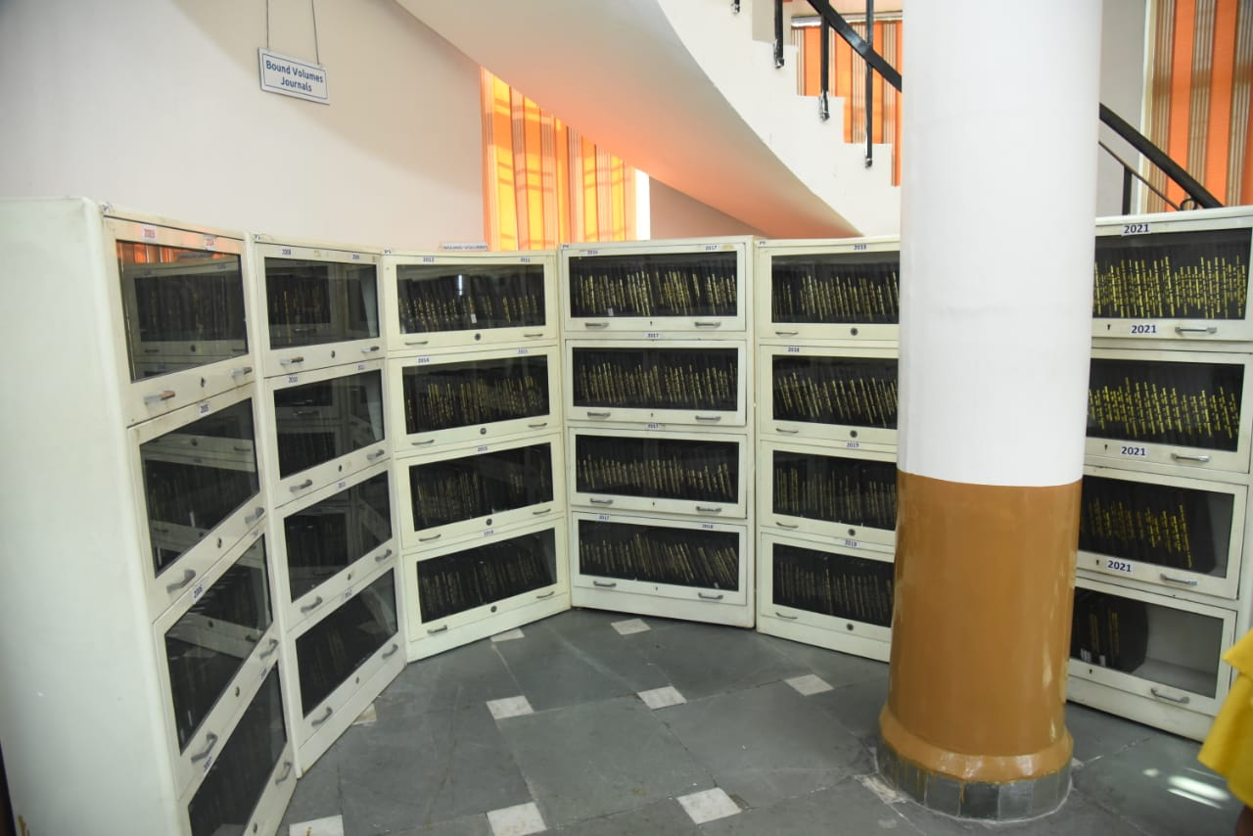
BOUND VOLUMES SECTION JOURNALS 2003-2024

Slide 69
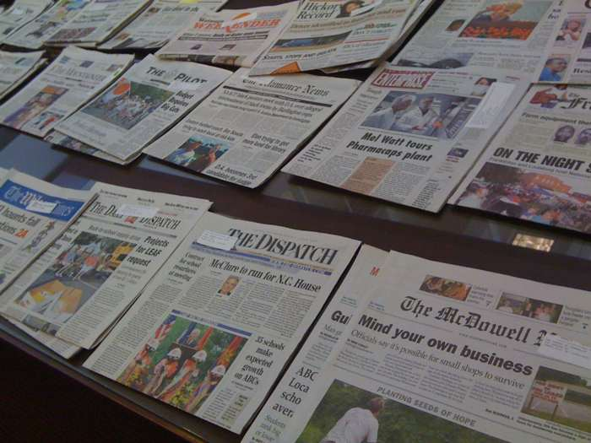

ENGLISH NEWSPAPERS
1. The Tribune
2. Hindustan Times
3. The Times of India
4. Indian Express
5. The Hindu
6. The Financial Express
7. Business Standard
8. Economic Times
9. Economic Times Wealth
HINDI NEWSPAPERS
10. Punjab Kesari
11. Dainik Bhaskar
12. Amar Ujala
13 Dainik Savera
14. Ajit Samachar
14. Divya Himachal5
16. Hindi Tribune
PUNJABI NEWSPAPERS
17. Jagbani
18. Punjabi Jagran
19. Ajit
20. Punjabi Tribune
21. Rozana Spokesman

Slide 70

LIST OF MAGAZINES
INDIA TODAY (ENG.)
INDIA TODAY ( HINDI)
PC QUEST
BUSINESS TODAY
BUSINESS WORLD
DIGIT
COMPETITION SUCCESS REVIEW
FRONTLINE
SCIENCE REPORTER
TRAVEL AND LEISURE

Slide 71
LIST OF MAGAZINES CONTD.
AUTOCAR
OUTLOOK
PRATIYOGITA DARPAN
YOJNA
THE WEEK
EMPLOYMENT NEWS
GOOD HOMES
ELECTRONICS FOR YOU
LINUX FOR YOU
HAPPIEST HEALTH
OUTLOOK TRAVELLER

Slide 72
CHANDIGARH ENGINEERING COLLEGE- CGC
Library Rules
All students/users must observe total silence in the library and its environs at all times
All users/students are required to scan their College/Library ID Cards while entering the library. No one will be allowed to enter the Library without ID Card.
All students must present their Library ID Cards before borrowing any library material.

Slide 73
Library Rules CONTD.
In case of loss of ID and Reader’s Tickets, the duplicate ID card will be provided against Rs. 100/- and Readers’ Tickets against Rs.20/- each.
In case any book is lost or damaged by the borrower, he/she shall replace the latest issue of the book or set of books if one volume of the set is lost, or shall pay twice the cost of the book, within a period of 15 days, with delay fine if any.
Personal Books, Bags/ belongings, eatables, and mobile phone use are not allowed inside the library. A fine of Rs.100/- may be charged from the defaulters.

Slide 74
Library Rules CONTD.
The students/users are required to maintain discipline and silence within the library premises. In case of indiscipline, the Library Membership will be cancelled.
The students/users cannot take any book, magazine, or newspaper, outside the library without permission.
The Circulation Timing will strictly be between 9:30 AM to 4:30 PM without any break, on all working days.
The students will be issued 3 books against 3 Reader’s Tickets at a time, for 21 days. The books in demand will be issued for 7 days.
All students have to return all the library books issued against their names before the start of the new semester

Slide 75



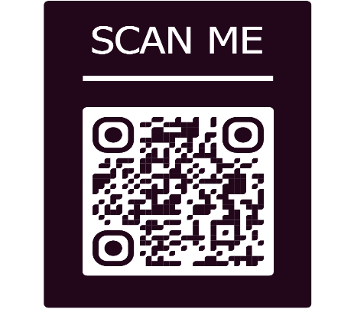


CEC-CGC LIBRARY NEWSLETTER LIBRARY BUZZ
1st Issue Sep 2023 | 2nd Issue April 2024 | 3rd Issue Nov 2024
4th Issue Feb 2025 | 5th Issue Sep 2025 | 6th Issue April 2026

Slide 76

FOR ANY QUERY / SUGGESTION CONTACT :
Renu Oberoi
Chief Librarian
Chandigarh Engineering College- CGC, Landran
0172-3984229
8872014309
chief.librarian@cgc.edu.in
FOR SUGGESTIONS

Slide 77
Ready to HELP YOU.
THANK YOU

